Slide 1
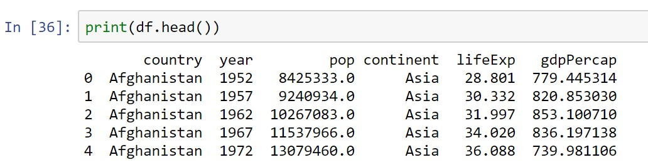
Looking at Columns, Rows, and Cells
Subset Rows by Index Label: loc

Slide 2
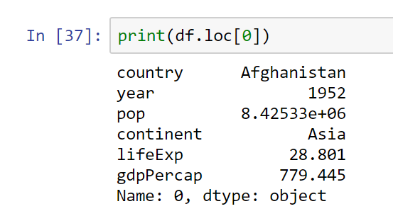
get the first row
Python counts from 0

Slide 3
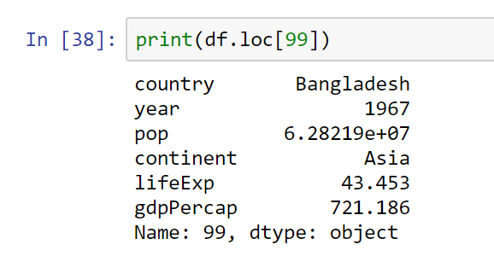
# get the 100th row
# Python counts from 0

Slide 4
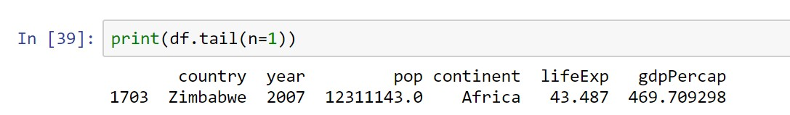
get the last row

Slide 5
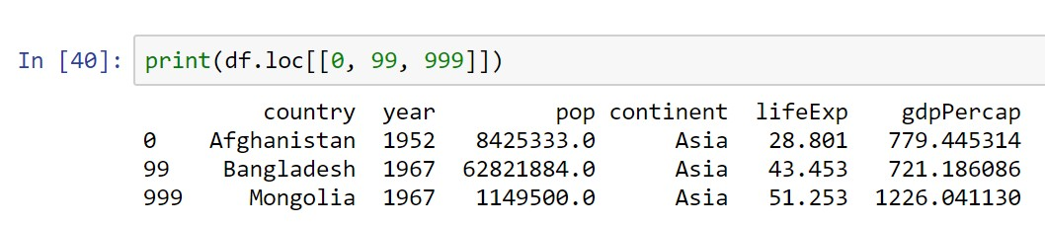
Subsetting Multiple Rows
# select the first, 100th, and 1000th rows

Slide 6
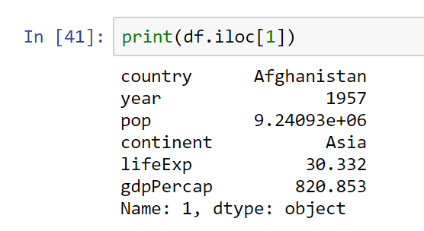
Subset Rows by Row Number: iloc
# get the 2nd row

Slide 7
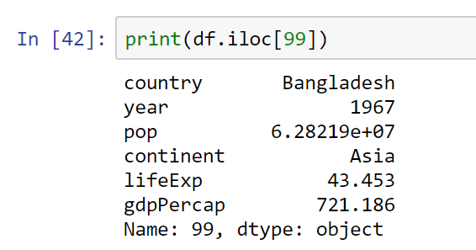
get the 100th row

Slide 8
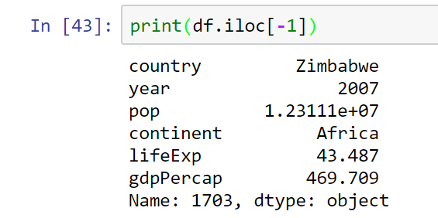
# using -1 to get the last row

Slide 9
With iloc, we can pass in the -1 to get the last row—something we couldn’t do with loc.

Slide 10
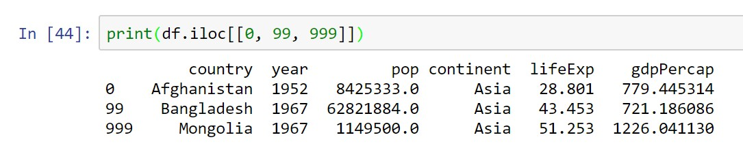
# get the first, 100th, and 1000th rows

Slide 11
Subsetting Columns
The Python slicing syntax uses a colon, :
If we have just a colon, the attribute refers to everything.
So, if we just want to get the first column using the loc or iloc syntax, we can write something like df.loc[:, [columns]] to subset the column(s).

Slide 12
# subset columns with loc
# note the position of the colon # it is used to select all rows

Slide 13
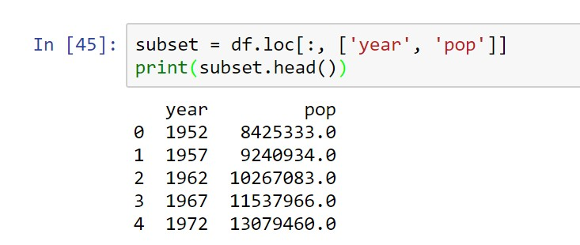

Slide 14
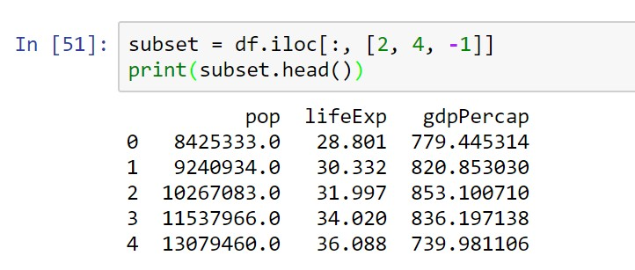
# subset columns with iloc
# iloc will alow us to use integers
# -1 will select the last column

Slide 15
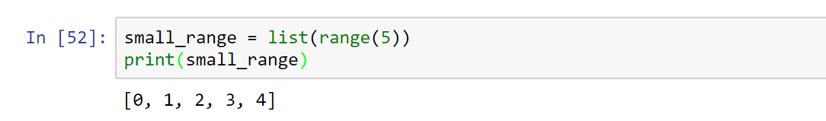
Subsetting Columns by Range
# create a range of integers from 0 to 4 inclusive

Slide 16
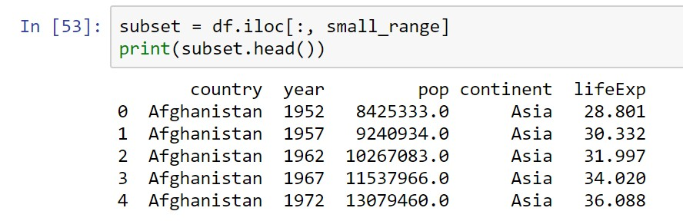
# subset the dataframe with the range

Slide 17
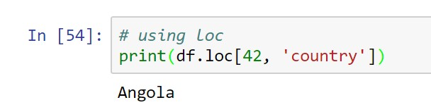
Subsetting Rows and Columns
# using loc

Slide 18
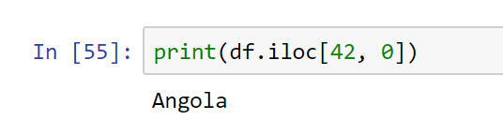
# using iloc

Slide 19
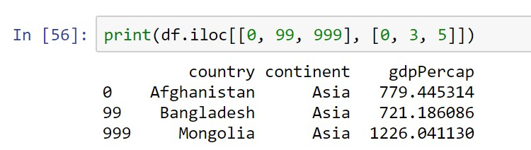
Subsetting Multiple Rows and Columns
#get the 1st, 100th, and 1000th rows # from the 1st, 4th, and 6th columns

Slide 20
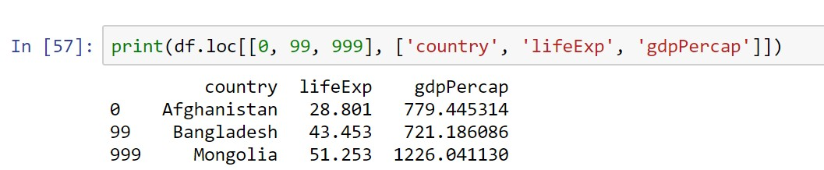
if we use the column names directly,
# it makes the code a bit easier to read
# note now we have to use loc, instead of iloc

Slide 21
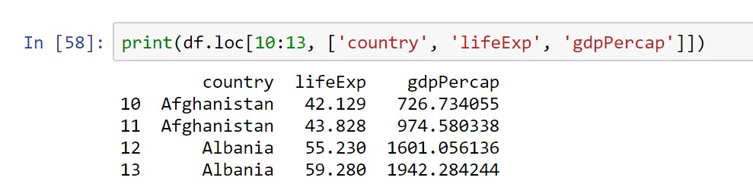

Slide 22
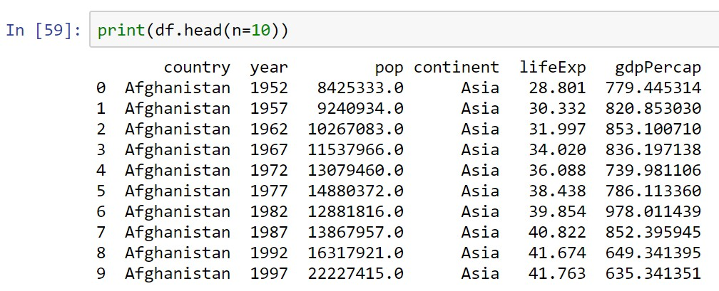

Slide 23
Grouped Means
# For each year in our data, what was the average life expectancy?
# To answer this question,
# we need to split our data into parts by year;
# then we get the 'lifeExp' column and calculate the mean

Slide 24
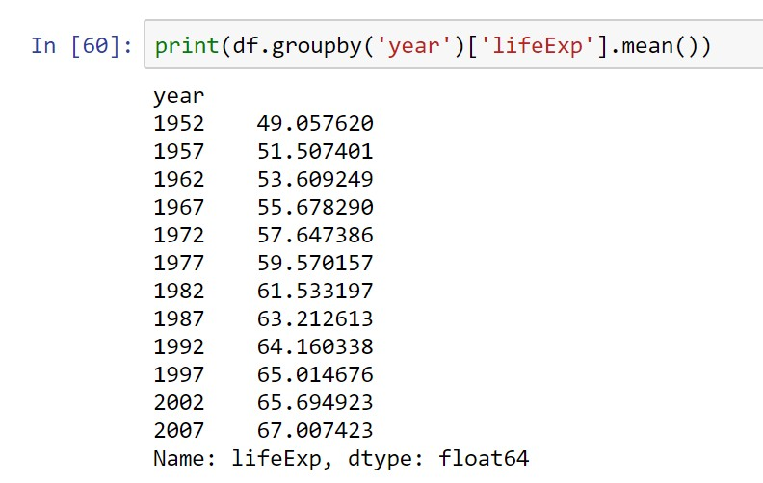

Slide 25
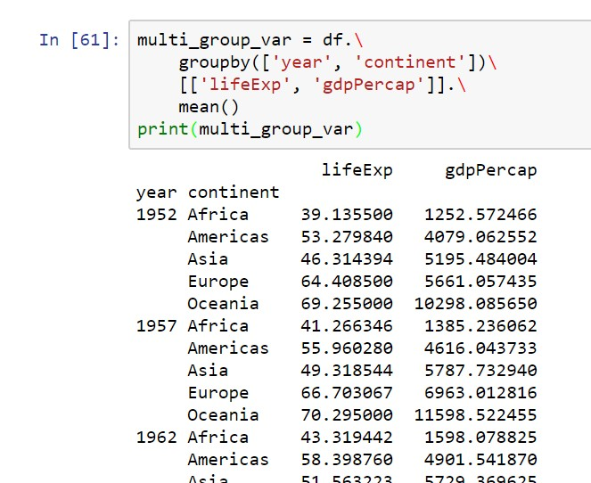

Slide 26
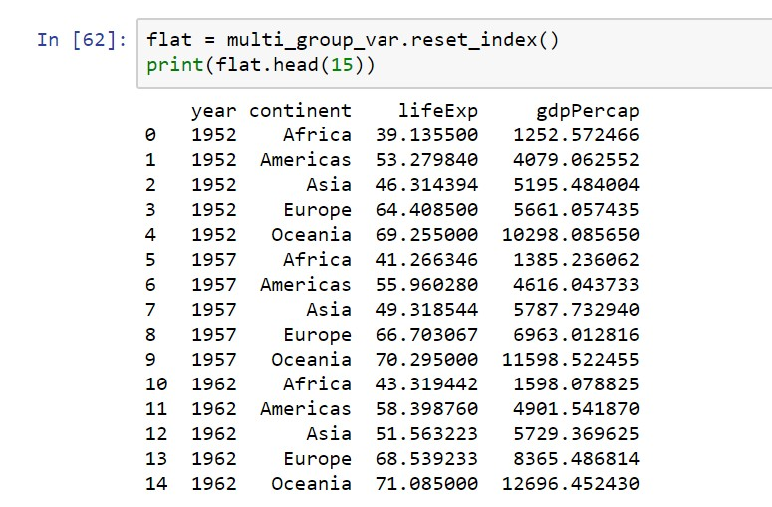
If you need to “flatten” the dataframe, you can use the
reset_index method.

Slide 27
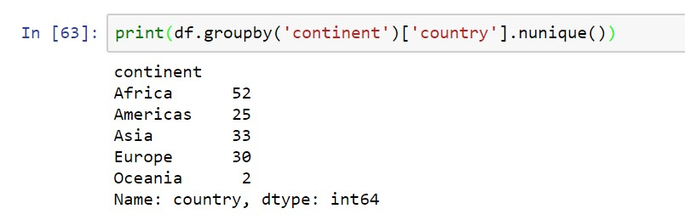
Grouped Frequency Counts
use the nunique to get counts of unique values on a Pandas Series.

Slide 28
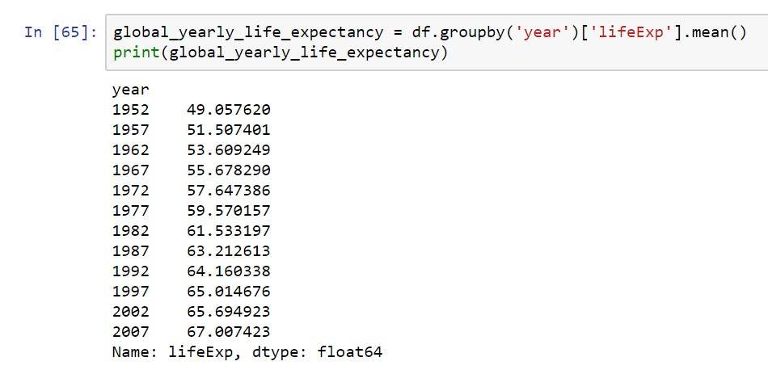
Basic Plot

Slide 29
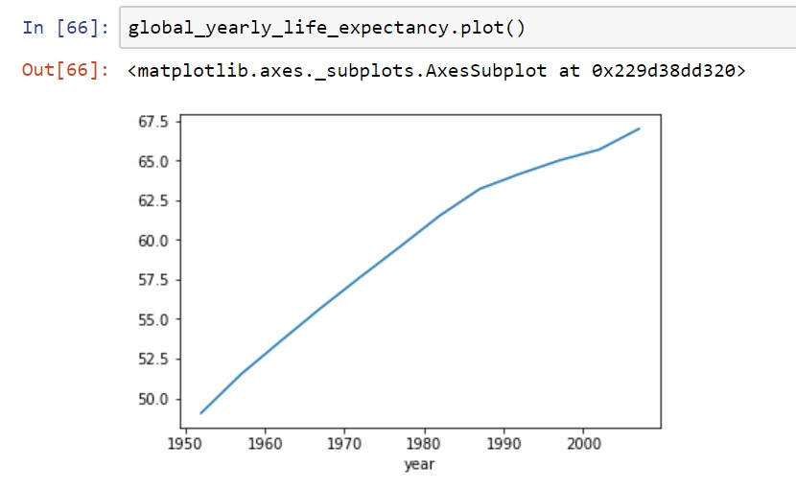

Slide 30
Visual Representation of the Data
Histogram -- vertical bar chart of frequencies
Frequency Polygon -- line graph of frequencies
Ogive -- line graph of cumulative frequencies
Pie Chart -- proportional representation for categories of a whole
Stem and Leaf Plot
Pareto Chart
Scatter Plot

Slide 31
Methods of visual presentation of data
Table
 | 1st Qtr | 2nd Qtr | 3rd Qtr | 4th Qtr
East | 20.4 | 27.4 | 90 | 20.4
West | 30.6 | 38.6 | 34.6 | 31.6
North | 45.9 | 46.9 | 45 | 43.9

Slide 32
Methods of visual presentation of data
Graphs
90
80
70
60
50
40
30
20
10
0
East West North
1st Qtr
2nd Qtr
3rd Qtr
4th Qtr

Slide 33
Methods of visual presentation of data
Pie chart
1st Qtr
2nd Qtr 3rd Qtr 4th Qtr

Slide 34
Methods of visual presentation of data
Multiple bar chart
4th Qtr
3rd Qtr
North
West East
2nd Qtr
1st Qtr
0
20
40
60
80
100

Slide 35
Methods of visual presentation of data
Simple pictogram
100
80
60
40
20
0
North
East
1st Qtr
2nd Qtr
3rd Qtr
4th Qtr
West

Slide 36
Frequency distributions
Frequency tables
Observation Table
Class Interval | Frequency | Cumulative Frequency
< 20 | 13 | 13
<40 | 18 | 31
<60 | 25 | 56
<80 | 15 | 71
<100 | 9 | 80

Slide 37
Frequency diagrams
Frequency
30
25
20
15
10
5
0
Cumulative Frequency
Frequency
90
80
70
60
50
40
30
20
10
0
Cumulative Frequency
< 20
<40
<60
<80
<100
Frequency
30
25
20
15
10
5
0
< 20 <40 <60 <80 <100
Frequency
< 20
<40
<60
<80
<100

Slide 38
Histogram
0 10 20 30 40 50 60 70 80
Years
20
Class Interval Frequency
20-under 30
30-under 40
40-under 50
50-under 60
60-under 70
70-under 80
6
18
11
11
3
1
Frequency
10
0

Slide 39






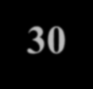

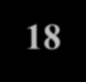
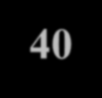







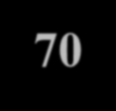


Histogram Construction
Class Interval Frequency
0 10 20 30 40 50 60 70 80
Years
20
20-under 30
30-under 40
40-under 50
50-under 60
60-under 70
70-under 80
6
18
11
11
3
1
Frequency
10
0

Slide 40
Frequency Polygon
0 10 20 30 40 50 60 70 80
Years
20
Class IntervalFrequency
20-under 30 | 6
30-under 40 | 18
40-under 50 | 11
50-under 60 | 11
60-under 70 | 3
70-under 80 | 1
Frequency
10
0

Slide 41
Ogive
Cumulative Frequency 6
24
35
46
49
50
60
Class Interval
20-under 30
30-under 40
40-under 50
50-under 60
60-under 70
70-under 80
Frequency
40
20
0
0 10 20 30 40 50 60 70 80
Years

Slide 42
Relative Frequency Ogive
Cumulative
Relative
Frequency
.12
.48
.70
.92
.98
1.00
Cumulative Relative Frequency
1.00
0.90
0.80
0.70
0.60
0.50
0.40
0.30
0.20
0.10
0.00
Class Interval 20-under 30
30-under 40
40-under 50
50-under 60
60-under 70
70-under 80
0 10 20 30 40 50 60 70 80
Years

Slide 43
Pareto Chart
100
90
80
70
60
50
40
30
20
10
0
100%
90%
80%
70%
60%
50%
40%
30%
20%
10%
0%
Frequency
Poor Short in Wiring Coil
Defective Plug
Other

Slide 44
Scatter Plot
Registered Vehicles (1000's) | Gasoline Sales (1000's of Gallons)
5 | 60
15 | 120
9 | 90
15 | 140
7 | 60
200
Gasoline Sales
100
0
0
5
10 15
Registered Vehicles
20

Slide 45
Principles of Excellent Graphs
The graph should not distort the data
The graph should not contain unnecessary adornments (sometimes referred to as chart junk)
The scale on the vertical axis should begin at zero
All axes should be properly labeled
The graph should contain a title
The simplest possible graph should be used for a given set of data

Slide 46






Graphical Errors: Chart Junk
Bad Presentation
✓
Good Presentation
Minimum Wage
1960: $1.00
Minimum Wage
$
4
1970: $1.60
2
1980: $3.10
0
1990: $3.80
1960 1970 1980 1990

Slide 47
Graphical Errors: Compressing the Vertical Axis
Bad Presentation
✓
Good Presentation
Quarterly Sales
Quarterly Sales
$
$
200
50
100
25
0
0
Q1 Q2
Q3
Q4
Q1
Q2
Q3
Q4

Slide 48


















Graphical Errors: No Zero Point on the Vertical Axis
Bad Presentation
Good Presentations
$ Monthly Sales
Monthly Sales
$
45
42
39
36
45
42
39
36
0
J F M A M J
J
F M
A M J
Graphing the first six months of sales

